Slide 1
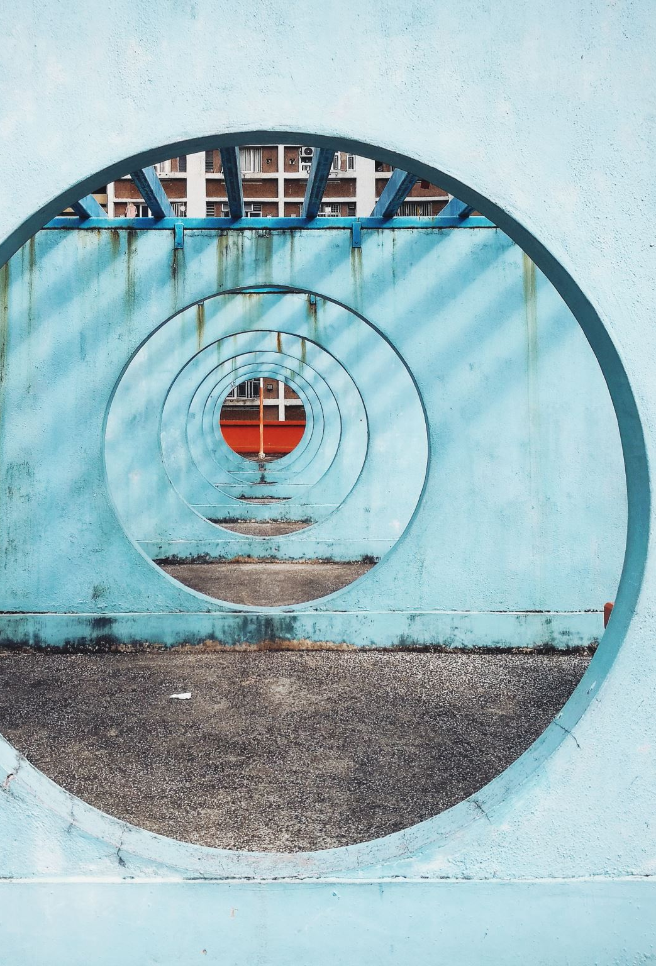
Sewerage system

Slide 2
Water carriage system / sewerage system
Collecting and transporting of human excreta and waste water from residential, commercial and industrial areas, by a net-work of underground pipes, called sewers to the place of ultimate disposal.
It is the method of choice for collecting and transporting sewage from cities and towns where population density is high.
There are two types in water carriage system –
Combined system, the sewers carry both the sewage and surface water.
Separate system, surface water is not admitted into sewers.
It is considered the system of choice today.
Although the first sewers were laid in 1867 in Calcutta, the Mudaliar Committee (1962) reported that not more than 15 per cent of the urban population in India had the amenity of a sewerage system.
The problem is one of economics - a heavy outlay of capital is needed to install a water-carriage system.
Water is needed for flushing the toilets and for conveying the human wastes, there can be no sewerage system without a piped water supply.

Slide 3
Elements
Household sanitary fittings (plumbing system of buildings)
House sewers
Street sewers or trunk sewers
Sewer appurtenances : manholes, traps, etc.

Slide 4
Household sanitary fittings
The usual household sanitary fittings are : (i) water closet, (ii) urinal and (iii) wash basin.
WATER CLOSETS may be broadly divided into two types : Indian squatting type and the Western commode type.
The water seal area should not be more than 7.5 cm.
There should not be any sharp corners in the trap design
The volume of water in trap should be as little as possible, preferably not exceeding 1.75 litres to maintain a minimum of 50 mm deep water seal.
The interior of the bowl should be vertical at least 50 to 75 mm just above the surface of water seal.
The water closets are provided with a ‘flushing rim’.

Slide 5
Household sanitary fittings
Human excreta is directly received into the water in the closet without soiling the sides.
The flushing removes all traces of excreta from the sides and keeps the closet clean.
The closet is connected to a small cistern by a pipe 2.5 to 3.75 cm (1-1.5 in.) in diameter.
The flushing cistern normally holds 15 litres (3 gallons) of water and works by syphonic action.
The flushing cisterns can be classified as high level, low level and integrated depending upon the height of location above the water closet bowl or pan.
The Indian squatting type W.C. pans are used with a high level flushing cisterns.

Slide 6
House drain
The house drain is usually 10 cm (4 in.) in diameter and is laid in the courtyard about 15 cm (6 in.) below the ground level on a bed of cement concrete with sufficient gradient towards the main drain.
The house drain empties the sewage into the main sewer or public drain.
Public sewer
The trunk sewers are not less than 22.5 cm (9 in.) in diameter; bigger ones may be 2 to 3 m (8-10 ft.) in diameter.
They are laid on a bed of cement concrete, about 3 m (10 ft.) below the ground level, with sufficient gradient to ensure what is known as “self-cleansing” velocity; this varies from 2 to 3 feet per second.
The trunk sewers collect sewage from several houses and transport to the main outfall or place of final disposal.

Slide 7
Sewer appurtenances
These are (a) manholes and (b) traps.
MANHOLES are openings built into the sewerage system.
Whenever there is a change in the direction of sewers
At the meeting point of two or more sewers,
At distances of 100 metres in long straight runs.
These openings permit a man to enter the sewer for inspection, repairs and cleaning.
Workers entering the manholes are liable to gas poisoning and asphyxiation.
TRAPS are of various kinds, these are devices designed to prevent foul gases entering the houses and to remove sand, grit and grease from sewage.
Under the basin of water closets,
Where the house drain joins the public drain (intercepting trap),
Where surface waste water enters the drains.
Sewer systems are designed, like water supplies, for service for one generation (30 years).

Slide 8
Sewage
Sewage is waste water from a community, containing solid and liquid excreta, derived from houses, street and yard washings, factories and industries.
It resembles dirty water with an unpleasant smell.
The term “sullage” is applied to waste water which does not contain human excreta, e.g., waste water from kitchens and bathrooms.
The amount of sewage that flows in the sewers depends upon :
Habits of the people : If people use more water, there will be more sewage
Time of day : Sewage does not flow uniformly throughout the day.
It is subject to variations depending upon the time of day and during different seasons.
In the morning, when people tend to use more water there is greater quantity and flow: in mid-day the flow is less, and again there is a slight increase in the evening.
The average amount of sewage which flows through the sewerage system in 24 hours is called the “dry weather flow.”

Slide 9
Health aspects
Creation of nuisance, unsightliness and unpleasant odours.
Breeding of flies and mosquitoes
Pollution of soil and water supplies
Contamination of food
Increase in the incidence of disease, especially enteric and helminthic diseases.

Slide 10
Composition of sewage
Sewage contains 99.9 per cent of water.
The solids which comprise barely 0.1 per cent are partly organic and partly inorganic; they are partly in suspension and partly in solution.
The offensive nature of the sewage is mainly due to the organic matter which it contains.
The organic matter decomposes according to the laws of nature during which process it gives off offensive odours.
In addition, sewage is charged with numerous living organisms derived from faeces, some of which may be agents to disease. It is estimated that one gram of faeces may contain about 1,000 million of E. coli, 10 to 100 million of faecal streptococci, and 1 to 10 million spores of Cl. Perfringens besides several others.
The average adult person excretes daily some 100 grams of faeces.

Slide 11
Aim of sewage purification
Raw sewage or inadequately treated sewage should not be discharged into rivers, sea or other sources of water supply.
The oxygen in the water supply is used up by the numerous aerobic bacteria found in the sewage.
The water may yield an offensive smell because of the release of hydrogen sulphide.
The aim of sewage treatment is to “stabilize” the organic matter so that it can be disposed off safely.
A standard test which is an indicator of the organic content of the sewage is biochemical oxygen demand (BOD).
It is defined as the amount of oxygen absorbed by a sample of sewage during a specified period, generally 5 days, at a specified temperature, generally 20 deg.C for the aerobic destruction or use of organic matter by living organisms.
BOD values range from about 1 mg per litre for natural waters to about 300 mg per litre for untreated domestic sewage.
If the BOD is 300 mg/L and above, sewage is said to be “strong”; if it is 100 mg/L, it is said to be “weak”

Slide 12
Aim of sewage purification
The COD test measures the oxygen equivalent of that portion of the organic matter in a sample which is susceptible to oxidation by a strong chemical oxidiser. If wastes contain toxic substances, this test may be the only practical method for determining the organic load,
SUSPENDED SOLIDS :
The suspended solids are yet another indicator of the “strength of sewage. The amount of suspended solids in domestic sewage may vary from 100 to 500 p.p.m. (mg/L).
If the amount of suspended solids is 100 mg/L, the sewage is said to be weak : if the amount is 500 mg/L the sewage is said to be strong.

Slide 13
Decomposition of organic matter
Aerobic process : It is the most efficient method of reducing the organic matter in sewage.
The process requires a continuous supply of free dissolved oxygen.
The organic matter is broken down into simpler compounds namely CO2,water, ammonia, nitrites, nitrates and sulphates by the action of bacterial organisms including fungi and protozoa.
Anaerobic process : Where the sewage is highly concentrated and contains plenty of solids, the anaerobic process is highly effective.
The end-products of decomposition are methane, ammonia, CO2 and H2.
The reactions are slower and the mechanism of decomposition extremely complex.

Slide 14
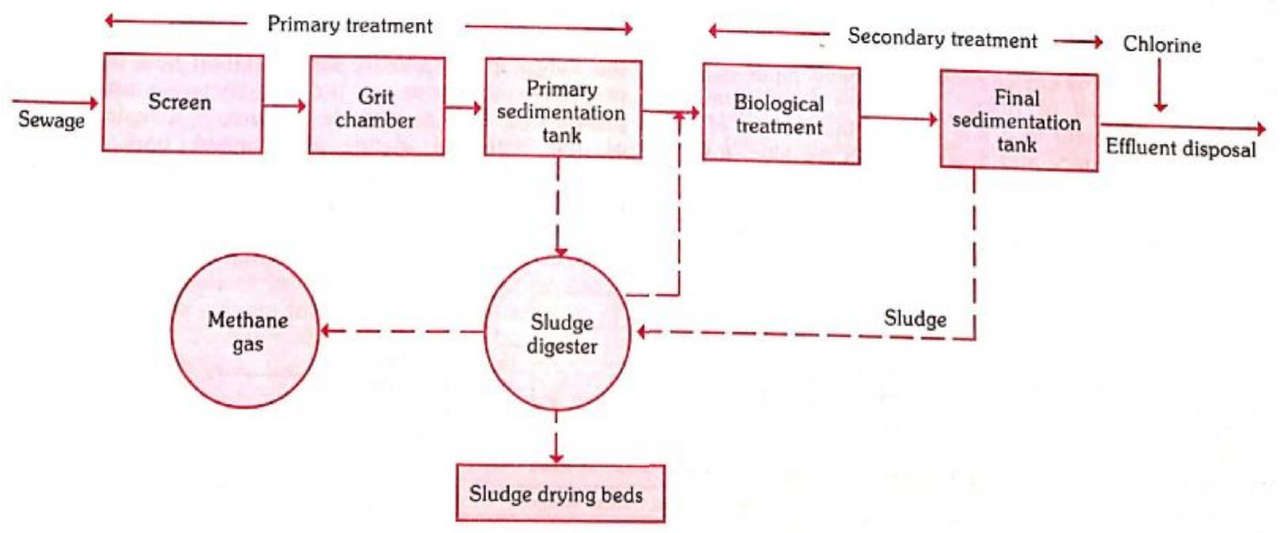
Modern sewage treatment
In primary treatment, the solids are separated from the sewage partly by screening and partly by sedimentation and subjected to anaerobic digestion which is the first stage in purification
In secondary treatment, the effluent is subjected to aerobic oxidation, which is the second stage in purification.

Slide 15
Screening
First passed through a metal screen which intercepts large floating objects such as pieces of wood, rags, masses of garbage and dead animals.
Their removal is necessary to prevent clogging of the treatment plant.
The screen consists of vertical or inclined steel bars usually set 5 cm (2 in) apart, in some plants, the screens are of the fixed type while in others, the screens are of the moving type.
The screenings are removed from time to time either manually or mechanically, and disposed off by trenching or burial.

Slide 16
Grit Chamber
Sewage is then passed through a long narrow chamber
This chamber is approximately 10 to 20 metres in length; it is so designed as to maintain a constant velocity of about 1 foot per second, with a detention period of 30 seconds to 1 minute.
The function of the grit chamber is to allow the settlement of heavier solids such as sand and gravel, while permitting the organic matter to pass through.
The grit which collects at the bottom of the chamber is removed periodically or continuously, and disposed off by plain dumping or trenching

Slide 17
Primary treatment
Very large tank, holding from ¼ to 1/3 the dry weather flow.
Sewage is made to flow very slowly across the tank at a velocity of 1-2 feet per minute. The sewage spends about 6-8 hours in the tank.
During this long period of relatively still conditions in the tank, a very considerable amount of purification takes place mainly through sedimentation of suspended matter.
Nearly 50-70 per cent of the solids settle down under the influence of gravity. A reduction of between 30 to 40 per cent in the number of coliform organisms is obtained.
The organic matter which settles down is called sludge and is removed by mechanically operated devices, without disturbing the operation in the tank.
A small amount of biological action also takes place in which the microorganisms present in the sewage attack complex organic solids and break them down into simpler soluble substances and ammonia.
A certain amount of fat and grease rise to the surface to form scum which is removed from time to time and disposed of.
When the sewage contains organic trade wastes, it is treated with chemicals such as lime, aluminium sulphate and ferrous sulphate. Addition of one of these chemicals precipitates the animal protein material quickly.

Slide 18
Secondary treatment
The effluent from the primary sedimentation tank still contains a proportion of organic matter in solution or colloidal state, and numerous living organisms.
It has a high demand for oxygen and can cause pollution of soil or water.
It is subjected to further treatment, aerobic oxidation, by one of the following methods :
(a) Trickling filter method
(b) Activated sludge process.

Slide 19
Trickling filter method
The trickling filter or percolating filter is a bed of crushed stones or cinker, 1 to 2 m (4-8 ft.) deep and 2 to 30 m (6-100 ft.) in diameter, depending upon the size of the population.
The device consists of hollow pipes each of which have a row of holes. The pipes keep rotating, sprinkling the effluent in a thin film on the surface of the filter.
Over the surface and down through the filter, a very complex biological growth consisting of algae, fungi, protozoa and bacteria of many kinds occurs. This is known as the “zoogleal layer”.
As the effluent percolates through the filter bed, it gets oxidized by the bacterial flora in the zoogleal layer. The action of the filter is thus purely a biological one, and not one of filtration as the name suggests. The term “filter” is a misnomer.
Wind blows freely through the beds supplying the oxygen needed by the zoogleal flora.
It is a light green, flocculent material and is called “humus”. The oxidized sewage is now led into the secondary sedimentation tanks or humus tanks.

Slide 20
Activated sludge process
The “heart” of the activated sludge process is the aeration tank.
The effluent from the primary sedimentation tank is mixed with sludge drawn from the final settling tank (also known as activated sludge or return sludge; this sludge is a rich culture of aerobic bacteria). The proportion of activated sludge to the incoming effluent is of the order of 20 to 30 per cent.
The mixture is subjected to aeration in the aeration chamber for about 6 to 8 hours. The aeration is accomplished either by mechanical agitation or by forcing compressed air continuously from the bottom of the aeration tank. This latter method, also known as ‘diffuse aeration’ is considered a better method of aeration.
During the process of aeration, the organic matter of the sewage gets oxidized into carbon dioxide, nitrates and water with the help of the aerobic bacteria in the activated sludge.

Slide 21
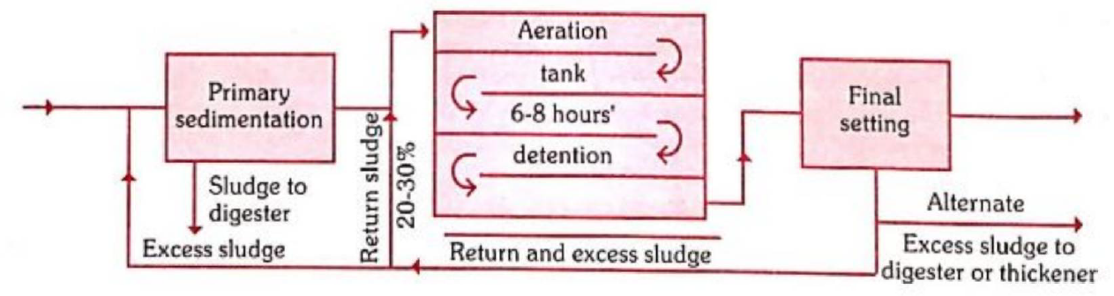
Activated sludge process
The typhoid and cholera organisms are destroyed, and the coliforms greatly reduced.
Activated sludge plants occupy less space, require skilled operations.
One acre of activated sludge plant does the work of 10 acres of percolating filter.
Activated sludge process is therefore, best suited for larger cities and the percolating filter for smaller towns because they are cheaper to install and easier to operate.

Slide 22
Secondary sedimentation
It is detained for 2-3 hours. The sludge that collects in the secondary sedimentation tank is called ‘aerated sludge’ or activated sludge, because it is fully aerated.
It differs from the sludge in the primary sedimentation tank in that it is
practically inoffensive and is rich in bacteriae, nitrogen and phosphates.
It is a valuable manure, if dehydrated.
Part of the activated sludge is pumped back into the “aeration tanks” in the activated sludge process and the rest pumped into the sludge digestion tanks for treatment and disposal.

Slide 23
Sludge digestion
One million gallons of sewage produces 15-20 tons of sludge.
The sludge is a thick, black mass containing 95 per cent of water, and it has a revolting odour.
Digestion : If sludge is incubated under favourable conditions of temperature and pH, it undergoes anaerobic auto-digestion in which complex solids are broken down into water, carbon dioxide, methane and ammonia.
The volume of sludge is also considerably reduced.
It takes 3_4 weeks or longer for complete sludge digestion.
The residue is in-offensive, sticky and tarry mud which will dry readily and form an excellent manure.
Sludge digestion is carried out in special tanks known as “sludge digestion tanks”.
Methane gas, which is a by-product of sludge digestion, can be used for heating and lighting purposes,
Sea disposal: Sea coast towns and cities can dispose of sludge by pumping it into the sea
Land : Sludge can be disposed off by composting with town refuse.

Slide 24
Disposal of effluent
Disposal by dilution : Disposal into water courses such as rivers and streams is called ‘disposal by dilution’.
The effluent is diluted in the body of water and the impurities are oxidized by the dissolved oxygen in water.
The diluting capacity of the river or the receiving body of water and its dissolved oxygen contents, are important considerations before discharging the effluent into a river or any body of water.
Since people use river water for drinking purpose, the effluent must be rendered free from pathogenic organisms by adequate chlorination.
The Royal Commission in England in its Fifth Report (1908) recommended that an effluent from a sewage treatment plant should not have more than 30 mg/litre of suspended solids and the 5 day B.O.D. of the effluent including the suspended matter, should not exceed 20 mg/litre.
These standards assumed that the river or body of water into which the effluent passed would provide an 8 :1 dilution.

Slide 25
Disposal of effluent
During the past few years, industry has developed hundreds of new chemicals which are released into the sewerage system. Some of these chemicals are not removed by biological treatment. Consequently, the effluent may contain substances toxic to man, or substances that can kill fish, damage agriculture or interfere with the normal functioning of a stream.
In many places in the UK, effluent standards have been raised from the original Royal Commission values of 30 mg per litre of suspended solids and 20 mg per litre of B.O.D. to 10 mg per litre of each.
The World Health Organization is seized with this problem, and is fostering research in “tertiary” methods of treatment or “polishing” the effluent further,
Disposal on land : If suitable land is available the effluent can be used for Irrigation purposes (e.g., the Okhla Sewage Treatment Plant in Delhi).

Slide 26
Other methods
Sea outfall
Sea coast towns and cities may dispose of their sewage by discharging it into the sea.
For instance, nearly two-thirds of untreated sewage of Greater Mumbai is discharged every day into the Arabian Sea.
Purification takes place by dilution in the large body of sea water, and the solids get slowly oxidized.
The drawback of this method is that the offensive solid matter may be washed back to the shore and create public nuisance.
In order to prevent this, the sewage outfall is designed to discharge the sewage into deep water at many points.
River outfall
Raw sewage should never be discharged into rivers.
The present day practice is to purify the sewage before it is discharged into rivers.

Slide 27
Land treatment (sewage farming)
Sewage may be applied to the land after grit removal, screening and a short period of settlement.
This type of treatment is practised in some Indian towns and cities and is known as Sewage Farming or Broad Irrigation.
An acre of land would be required to treat the sewage of 100-300 persons.
The land is first laid into ridges and furrows. Sewage is fed into the furrows intermittently and crops are grown on the ridges.
The crops that are found suitable to grow are those which do not come in contact with sewage and likely to be eaten raw. Fodder grass and potatoes seem to be the most paying crops. Fruit trees whose fruits are high above the ground (e.g., plantain) can be grown.
The farm should be under the direction of a competent agricultural expert.
Badly managed farms stink, a condition described as “sewage sickness” because of lack of sufficient aeration and rest pauses to the land.
Alternate methods of disposal may have to be provided during the rainy season

Slide 28
Oxidation pond
Aka waste stabilization pond, redox pond, sewage lagoons
The term “waste stabilization pond” is more appropriate. The term ‘waste* includes both sewage and industrial wastes.
The oxidation pond is an open, shallow pool 1 to 1.5 m (3-5 fl.) deep with an inlet and outlet
There must be the presence of (1) algae (2) certain types of bacteria which feed on decaying organic matter, and (3) sun-light.
The organic matter contained in the sewage is oxidized by bacteria (hence oxidation pond) to simple chemical compounds such as carbon dioxide, ammonia and water.
The algae, with the help of sunlight, utilize the carbon dioxide, water and inorganic minerals for their growth. Thus there is a mutually beneficial biological balance between the algae and bacteria in oxidation ponds.
Oxygen that is needed for oxidation is derived to a small extent from the atmosphere but mostly from the algae which liberates oxygen under the influence of sunlight.
Consequently, sunlight is an important factor in the proper functioning of oxidation ponds. Cloudy weather definitely lowers the efficiency of the process.

Slide 29
Oxidation pond
The oxidation ponds are predominantly aerobic during sunshine hours as well as some hours of the night. In the remaining hours of the night, the bottom layers are generally anaerobic.
Thus the sewage purification in oxidation ponds is brought about by a combination of aerobic and anaerobic types of bacteria.
The effluent may be used for growing vegetable crops (land irrigation) or may be discharged into a river or other water courses after appropriate treatment.
Mosquito nuisance is avoided by keeping weed growth in the neighbourhood of oxidation ponds to a minimum and the water line free from marginal vegetation.
There is no odour nuisance associated with these ponds when they are properly maintained.
Oxidation ponds have become an established method of purifying sewage for small communities

Slide 30
Social aspects of excreta disposal
Surveys have shown that substantial per cent of the population “go to the open fields” for defecation.
This habit of indiscriminate fouling of the surroundings with human excrement is generations-old, and rooted firmly in the cultural behaviour of the village people.
In urban areas, the latrine is considered a necessary part of a house.
In rural areas, by and large, people have not accepted latrines with any enthusiasm, and even when installed only a few used them regularly.
The solution to the problem lies in teaching the people first the reasons why latrines are important.
The teaching should be undertaken by all known methods of health education - direct discussion, group discussion, latrine demonstration, and use of visual aids and above all service facilities.
The ultimate goal of health education will be to motivate the rural people towards acceptance and use of sanitary latrines.

Slide 31
Social aspects of excreta disposal
Social scientists have listed the reasons why villagers do not accept latrines.
Latrines are associated with bad smell
They are the breeding places of flies
They are something foul and dirty so that one should not have them close to houses
Latrines are costly and beyond their means to install
They do not know how faecal-borne diseases are spread.
Using a latrine goes against a daily habit pattern of going to the fields.

Slide 32
Surface water drainage in urban areas
Set out regular plots before house building starts in an area,
Leaving space for well-aligned roads.
Adequate road width and alignment will make it much easier to build drains when they are needed later.

Slide 33

Thank you

